Slide 1
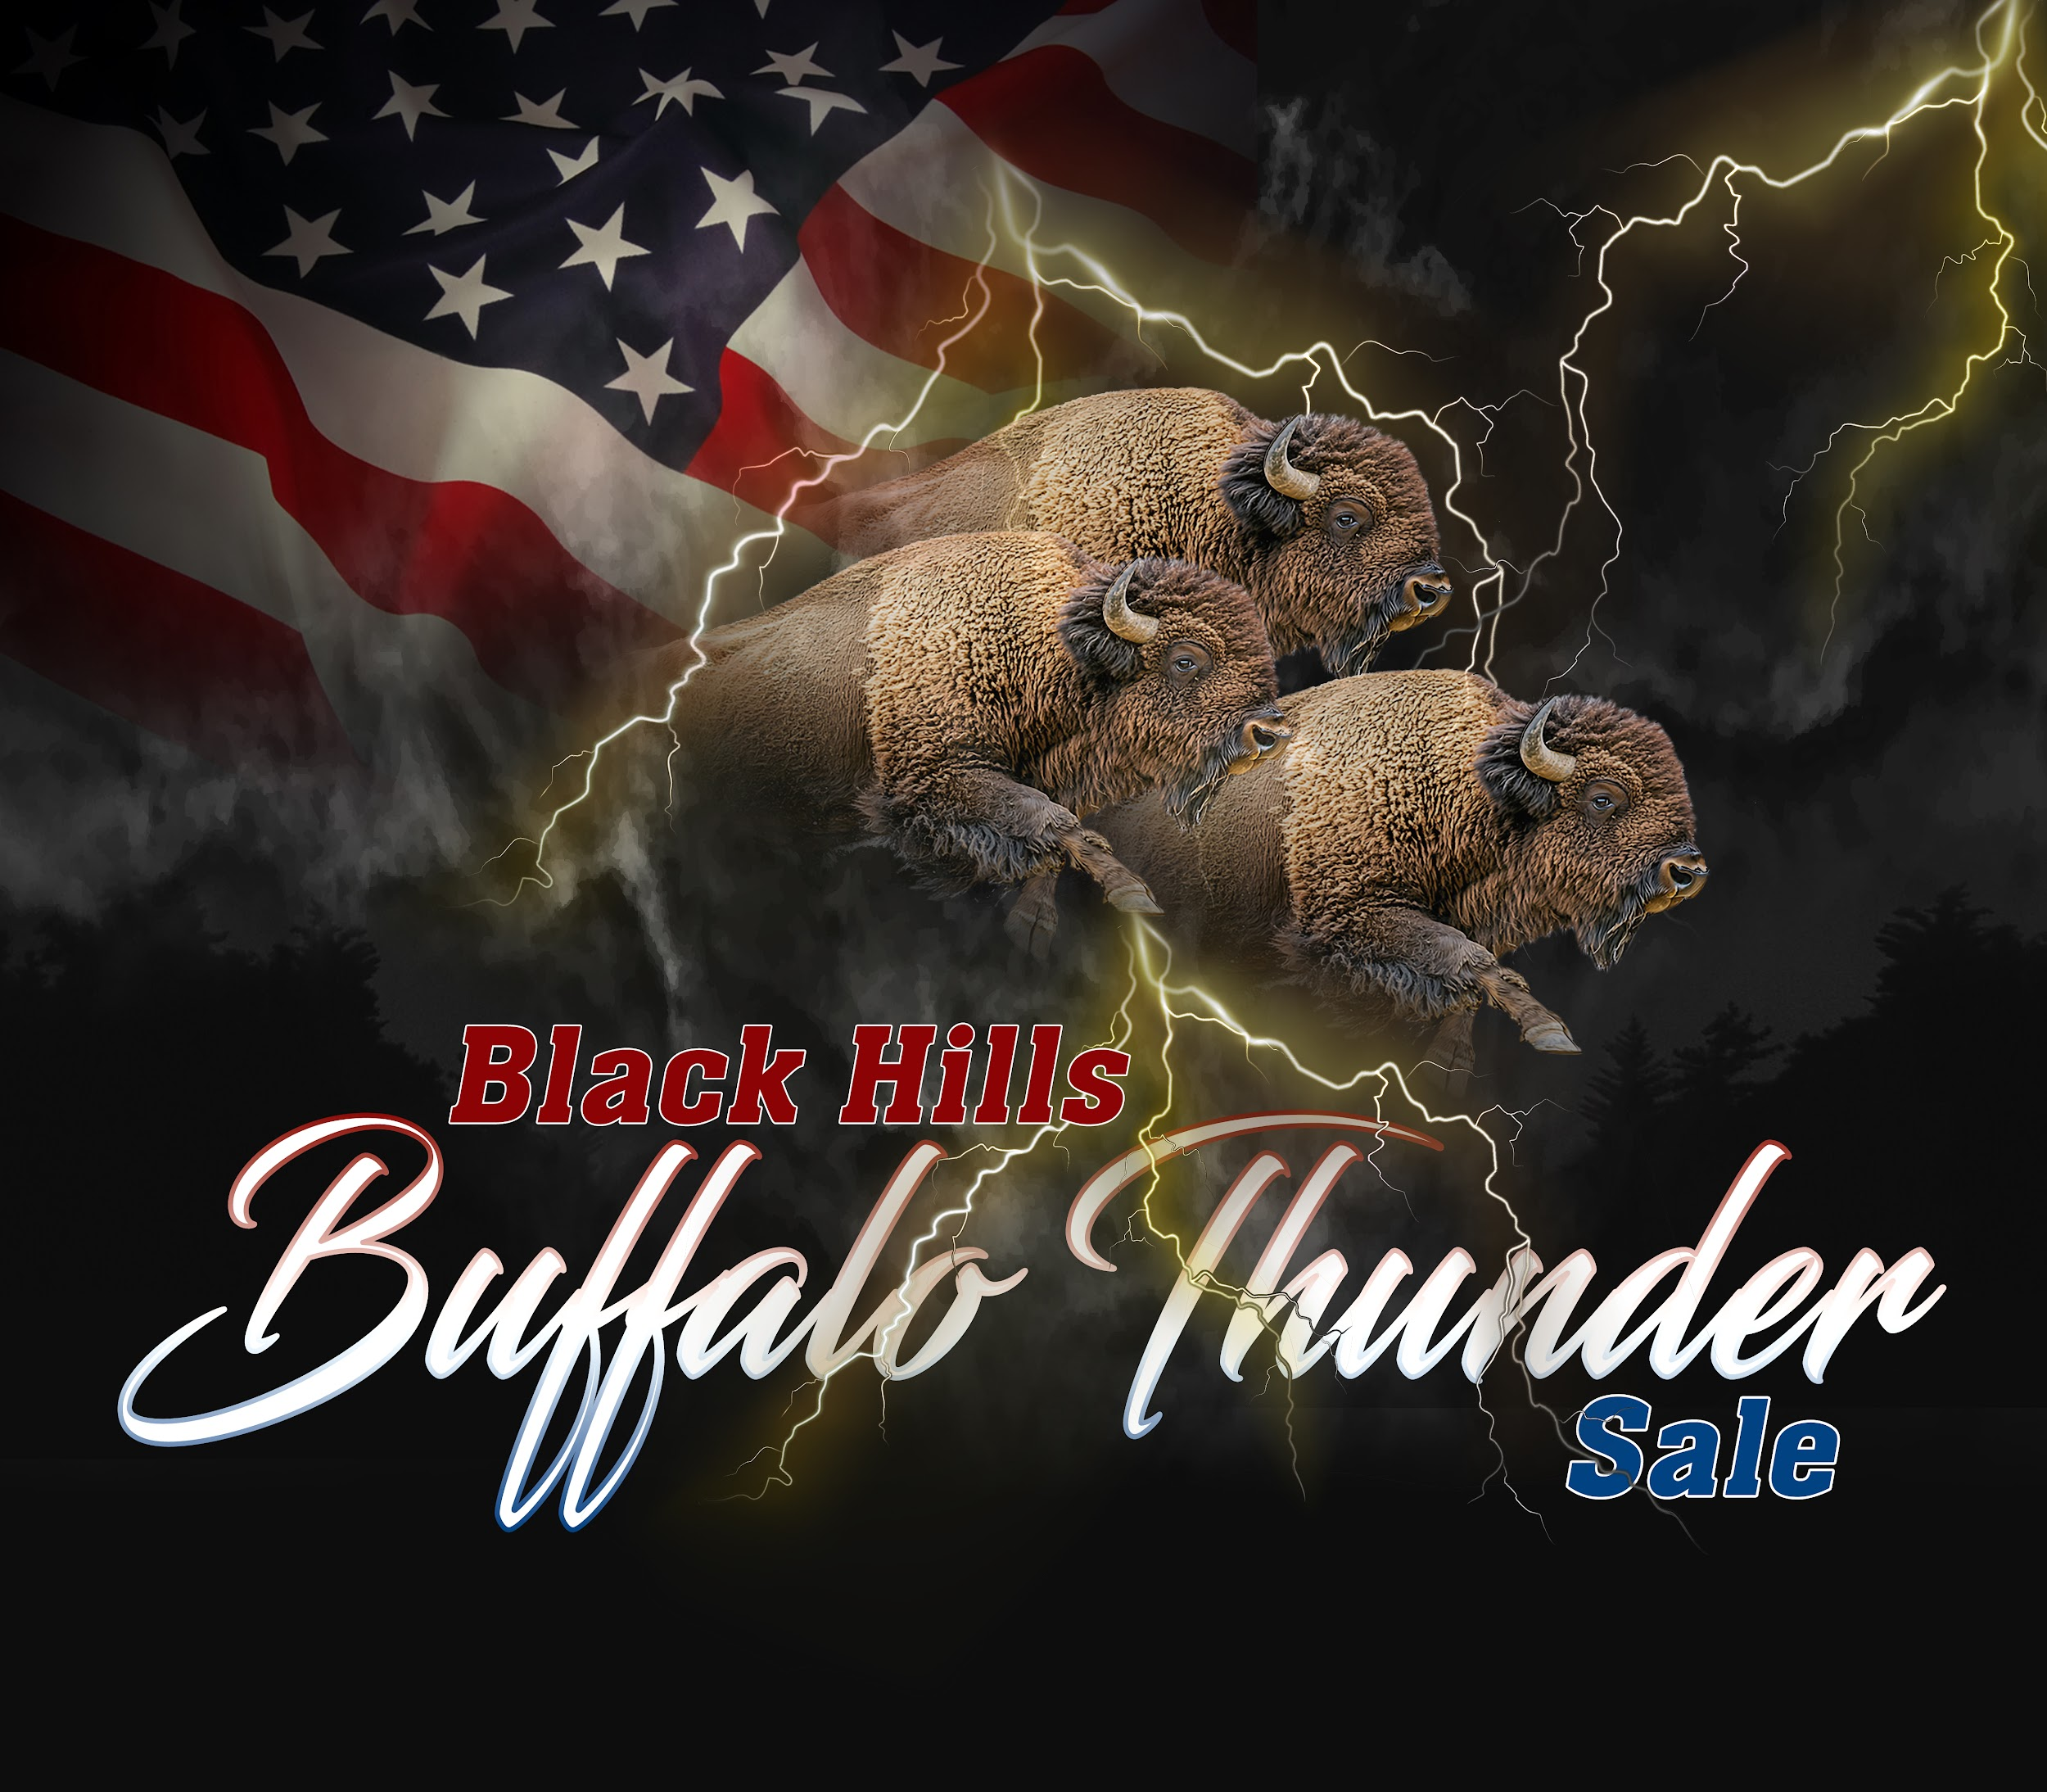

DTBA
Black Hills
Buffalo Thunder
Premier Bull Sale
Live Judging
Criteria
2025 Judges
Dick Gehring
David Lautt

Slide 2
Dakota Territory Buffalo Association
Black Hills Buffalo Thunder Live Judging Criteria Presentation
Educating buyers and guiding consignors to strengthen herds through informed judging of solid genetics for breeding & production excellence for a strong future of North American bison.
For the Consignor ~
Inform for what judges are looking for
Explanation for all 9 judging criterias
Structure based selection for longevity of propagation & production
For the Buyer ~
help point out strengths that they can apply to their own herd
Insight of scoring to help see each animal’s value and fit for your own herd
For the Bison Industry ~
Rebuild herds based on strong structure for longevity
Industry wide benefit as a result from consignor & buyer evaluations
Notes:
The Judges this year will be using a scoring system they and others adapted to the bison industry. THIS IS AN ATTEMPT TO EDUCATE THE MANY NEW BUYERS ENTERING THIS BUSINESS AND TRY TO INFORM THE CONSIGNORS WHAT THE JUDGES ARE LOOKING FOR. Perhaps it may help the consignors look for characteristics that will score well in this year’s competition as well as give guidance for consignors to decide what animals to enter the competition or leave at home for the slaughter pen.
We & the DTBA S/S Committee and Board, believe these characteristics are paramount for a breeding animal to stand up to the pressure of a life of reproduction & are essential for breeding animals to propagate.
With today’s limited buffalo inventory, the bison industry has a unique opportunity to rebuild the North American herd. The DTBA Black Hills Buffalo Thunder & Girlz Gone Wild Performance Class Contest Live Judging is dedicated to strengthening the future of the herd by promoting solid genetics and setting high standards for longevity, ensuring many years of propagation.
For the buyer, this type of scoring & explanation hopefully helps point out strengths that they can apply to their own herd. However, just because an animal does not have a perfect score or does not place in top 3 DOES NOT mean there is no value for it - judges must get very critical at these shows to justify placing animals - THE JUDGES AIM if for folks to evaluate their own herd and find the characteristics they have in abundance and also what characteristics they are missing or needing to improve on. With this criteria & explanation & by seeing the judges’ scoring at the DTBA show, buyers can better understand the value of each animal in a class and how they might fit into and strengthen their own herds at home.

Slide 3
Dakota Territory Buffalo Association
Black Hills Buffalo Thunder Live Judging Criteria Presentation
NINE Categories for a Total of 120 points
First Impression/Condition = 20 points
Soundness or Correct Legs & feet = 30 points
Top Line = 10 points
Depth = 10 points
Base Width = 10 points
Length of Torso from Point of Shoulder to Pin Bone = 10 points
Bone - Thickness & Correctness = 5 points
Hip Scores = 10 points
Head Scores = 5 points
Performance Measures = ADG Grass & ADG Grain ~ if provided, this information is extremely valuable for the discerning buyer to evaluate & will be included in sales catalog
Notes:
We & the DTBA S/S Committee and Board, believe these characteristics are paramount for a breeding animal to stand up to the pressure of a life of reproduction & are essential for breeding animals to propagate.
With today’s limited buffalo inventory, the bison industry has a unique opportunity to rebuild the North American herd. The DTBA Black Hills Buffalo Thunder & Girlz Gone Wild Performance Class Contest Live Judging is dedicated to strengthening the future of the herd by promoting solid genetics and setting high standards for longevity, ensuring many years of propagation.

Slide 4
FIRST IMPRESSION/CONDITION - 20 POINTS
~ The First Impression/Condition gives a judge that first impact that either catches their eye positively or negatively ~
POSITIVES
Overall Balance
Appearance that ‘POPS’
Way the animal MOVES/TRACKS
How they carry themselves
NEGATIVES
Indications of a very fat animal;
Excessive hump fat
Excessive globular fat at tail set
Width high above center of round
Notes:
First Impression/Condition gives a judge that first impact that either catches their eye positively or negatively. Often there is just something about the overall BALANCE and appearance that POPS. There are a number of factors in play here. FOR EXAMPLE, the way animals move or track, and how they carry themselves can be impressive. CONVERSELY, excessive hump fat and globular fat around the tail set or width high above the center of the round indicates a very fat animal and that width will be imagined removed or melted down to a base width for your muscle indication. CONSIGNORS, if you do not have confidence that the judges can gauge that accurately, consider bringing a leaner animal. This category being broad and diverse, receives a possible 20 points.

Slide 5
SOUNDNESS OR CORRECT LEGS & FEET-30 POINTS
Correct is Correct—Building Stronger Herds for Generations
Soundness matters: Correct legs and feet are paramount for a breeding animal to endure the pressures of a lifetime of reproduction.
Strong foundations: An animal’s foundation is just as critical as the foundation of your house.
Deficiencies take a toll: Flaws in the feet, skeleton, or musculature force the animal to compensate—at a cost to its health and performance.
Notes:
Soundness or correct legs and feet are PARAMOUNT for a breeding animal to stand up to the pressures of a life of reproduction. The foundation of an animal is just as important as the foundation on your house. If there are deficiencies present on the ground, the skeleton, or musculature, the animal will have to compensate and make up for those discrepancies. That comes at a cost to the animal. BOTH FRONT AND BACK LEGS will be taken into consideration. Soundness is essential for breeding animals to propagate. A STRAIGHT PLANE FROM THE REAR HOCK TO THE FETLOCK IS PARAMOUNT. There are a number of possible reasons for a deviation in the joint directly below the hock, or a malformation such as inbreeding in severe cases, trait selection, osteochondrosis, invitro issues, toxicities during pregnancy, overfeeding, etc. These can have debilitating effects on joint and bone development both invitro, as and throughout the young animal’s growth timeline. It is not the judge’s responsibilities to determine what the affliction is. THUS, any curvature to a joint or straight bone will receive a significant reduction in score.
OTHER SOUNDNESS REDUCTIONS in scoring will result if clicking or popping in the joints, whether ankle or hock, or other joints are observed. EXCESSIVE SWELLING in and around the lower feet just above the hooves (pastern) indicates overfeeding and overweight, or even possible heart failure.
Excuses have been made in the past surrounding travel distance or some other reason regarding debilitating problems. However, the judges will be judging what they see in front of them today. Tolerance for deficiencies because “some pastures are small, and travel isn’t as big of an issue, and oh he’ll be just fine” won’t be given an credence.
Correct is Correct and short-changing the gene pool because “he’s such a great animal otherwise” should not be an accepted practice.
THIS CATEGORY IS OF SIGNIFICANT IMPORTANCE AND GIVEN 30 POINTS.

Slide 6
SOUNDNESS OR CORRECT LEGS & FEET-30 POINTS Continued
Correct is Correct—Building Stronger Herds for Generations
Structural Evaluation
Both front and back legs will be considered.
Soundness is essential for breeding animals to propagate.
See next slide, slide #7, as example: A straight plane is present from Point A through Point B & continues to Point C. These hind legs are correct ~

Slide 7
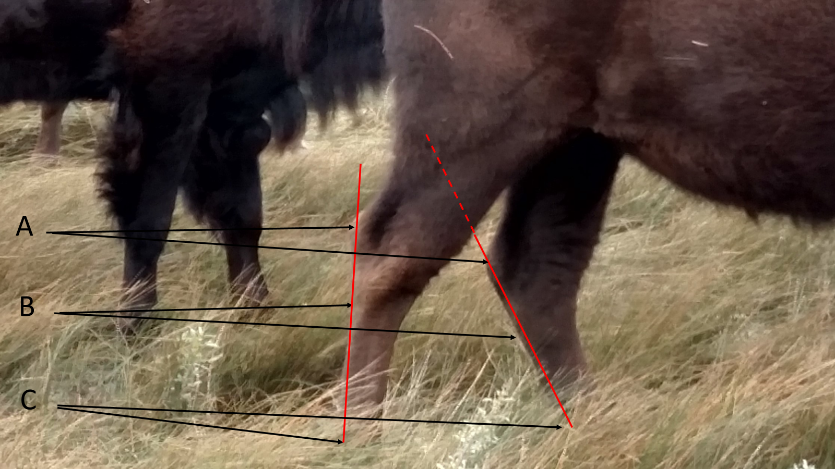

Slide 8
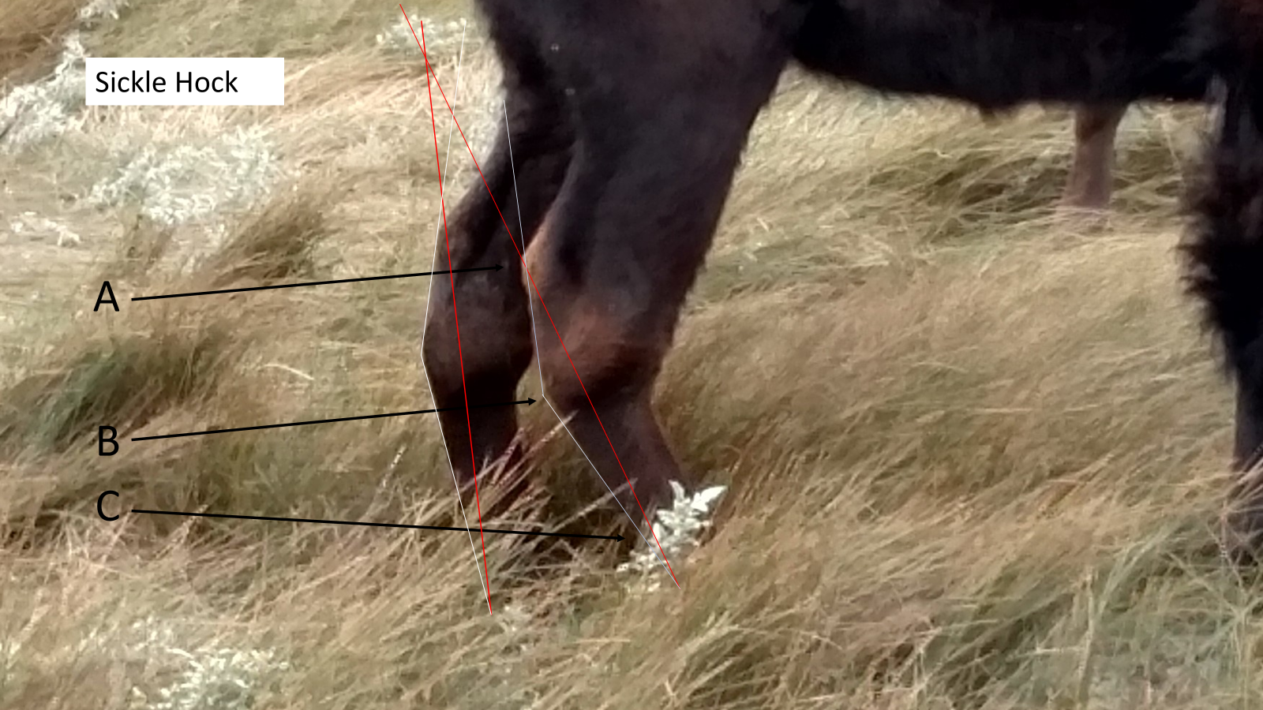
This picture shows a gross disease process to the joint, resulting in a severe angulation at POINT B.
The RED LINE is the correct plane from POINT A through POINT B to POINT C, while the deviated line is what is present for this animal.

Slide 9
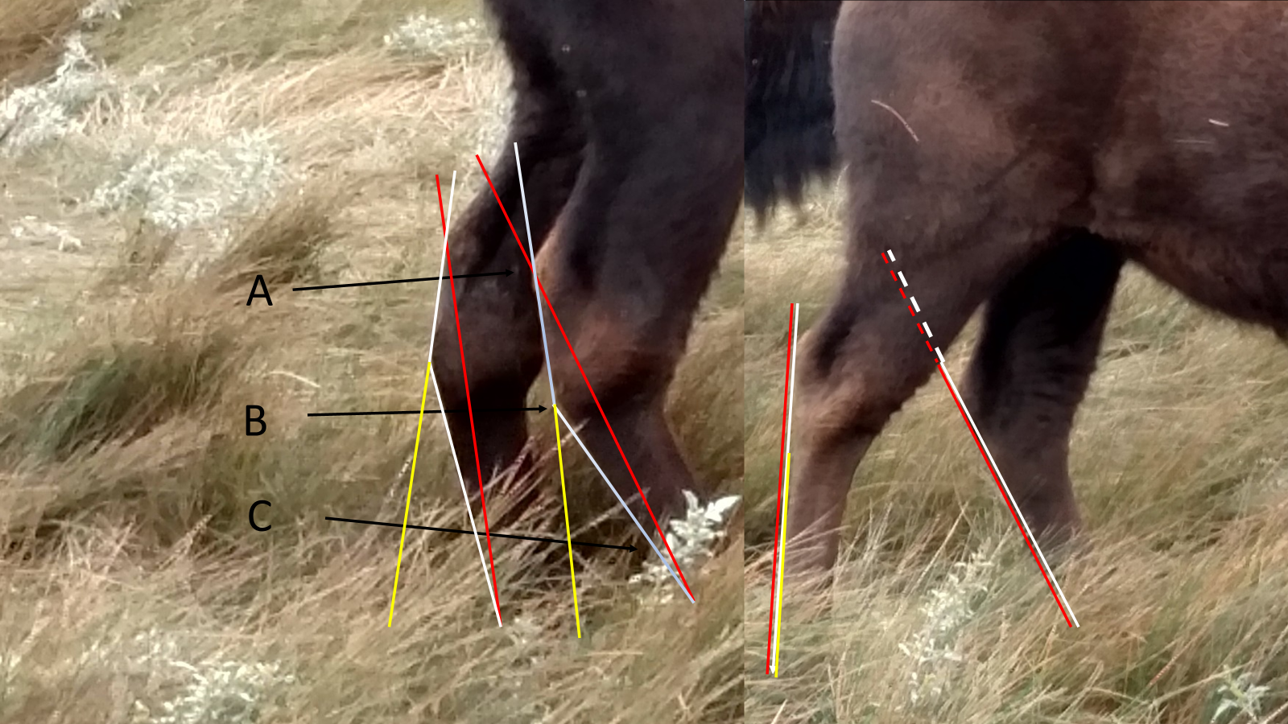
Red Lines: Correct Plane
White Lines: where plane actually is
Yellow Lines:
where white
Line would
Continue to , if it was on
A correct plane
Notes:
This slide shows the comparison of the two animals. The RED lines are the plane that should be, the WHITE line is where the plane actually is, and the YELLOW line shows where the white line would continue to, if it was a correct plane.

Slide 10
SOUNDNESS OR CORRECT LEGS & FEET-30 POINTS Continued
Correct is Correct—Building Stronger Herds for Generations
Other
Curvature: Any curvature that joint or in the straight bone below it will receive a significant score reduction.
Joint Soundness: Clicking or popping in the ankle, hock, or other joints will lower scores.
Swelling: Excessive swelling around the pastern (just above the hooves) may indicate overfeeding, overweight, or possible heart failure.
- Deviations or malformations in joints below the hock may occur for several reasons.

Slide 11
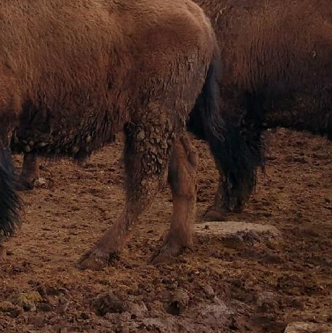
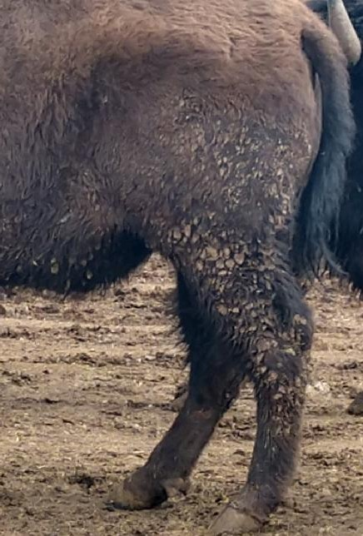
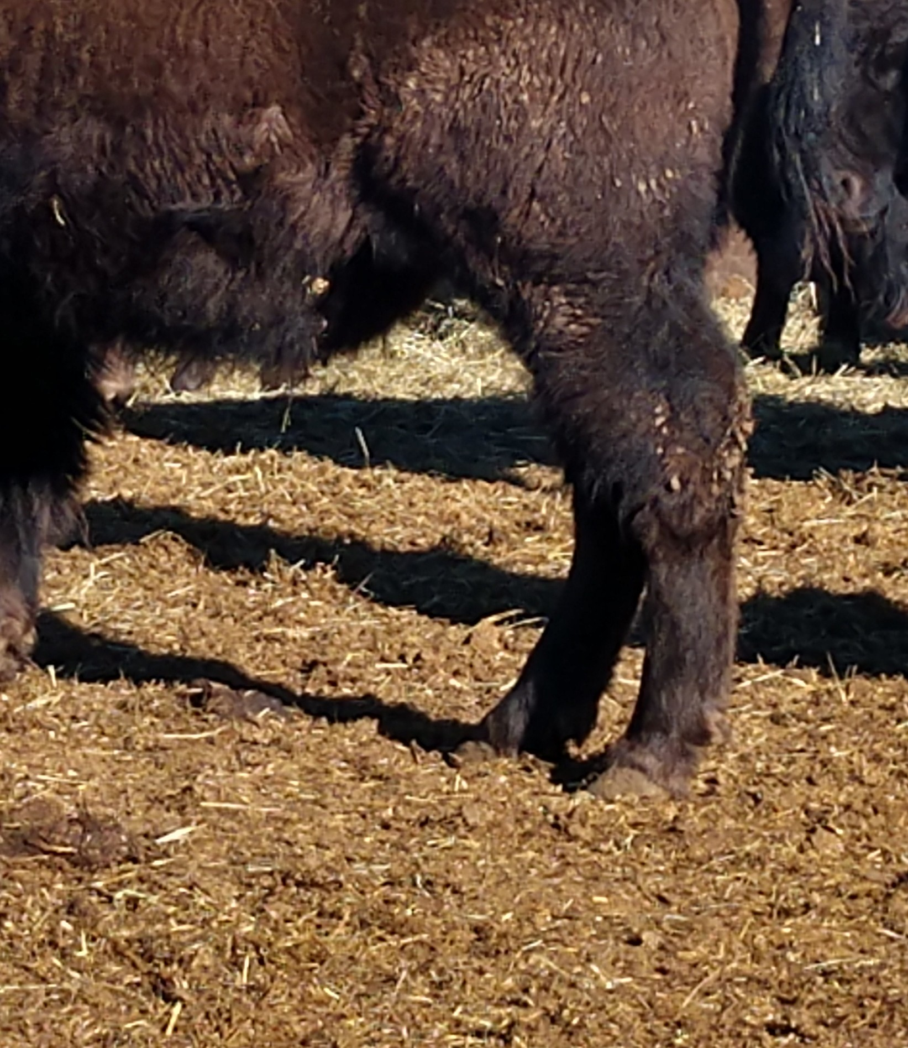
SOUNDNESS OR CORRECT LEGS & FEET-30 POINTS Continued
All three pictures below show some degree of bowing to the straight bone without angulation of the joint above. While the affliction is not as severe, this undesirable trait will cause point reductions

Slide 12
TOP LINE - 10 POINTS
CORRECT TOP LINE
Relatively straight plane from highest point of hump to tail set
Natural curves to toplines that don’t affect animal movement or flexibility are not in question
UNDESIRED
Rounded or rainbow looking back
Excessive sway back
Notes:
Top Line will be given 10 points. We are looking for a relatively straight plane from the highest point of the hump down to the tail set. A rounded or a rainbow looking back as well as an excessive sway back is not desired. Some natural curve to topline, especially in females is not necessarily a fault. In the past, judges may have incorrectly referred to the back as a straight topline instead of a CORRECT TOP LINE. That may have been the confusion leading to some thinking we were trying to get rid of the hump.

Slide 13
DEPTH - 10 POINTS
Depth can be described as the distance from the top of the shoulder to the brisket and how it carries that depth throughout the rest of the torso to the rear leg.
Notes:
Depth can be described as the distance from the top of the shoulder to the brisket and how it carries that depth throughout the rest of the torso to the rear leg.

Slide 14
BASE WIDTH - 10 POINTS
Base Width will be judged looking at the front and rear of the animal.
DESIRED
Some distance between the front & back legs
Wider stance for muscle capacity
NOT DESIRED
Narrow Frame ~ knees, hocks, or feet almost touching
An inch in width across an animal will carry more weight than you expect.
Notes:
Base Width will be judged looking at the front and rear of the animal. Some distance between the front and back legs is desired. Knees, hocks, or feet almost touching indicates a narrow frame. A wider stance indicates capacity for muscling. An inch in width across an animal will carry more weight than you expect.

Slide 15
LENGTH OF TORSO - 10 POINTS
Torso Length: Measured from the point of shoulder to the pin bone.
Loin Section: Special attention to the loin, which contributes to greater steak value.
Notes:
Length of torso from the point of shoulder to pin bone. Attention will be paid to the loin section that will generate a greater steak value.

Slide 16
BONE - 5 POINTS
Bone Evaluation: Judged by thickness and correctness.
Distinct from Legs: While similar, bone assessment is a separate evaluation from leg correctness.
Notes:
Bone will be judged by thickness and correctness. While this sounds a lot like correct legs, it is two different looks.

Slide 17
HIP SCORES - 10 POINTS
Hip Score Focus: Based on length from the hooks to the pins.
Hooks Defined: Knobby prominences along the back, just behind the flank.
Pins Defined: Rear end of the pelvis, parallel to the tail head.
Evaluation Factors: Alignment of the hooks-to-pins plane with the topline and how muscling carries down toward the hock.
Notes:
Hip scores will revolve around length from the hook to the pins. The hooks are the knobby prominences sticking out to the sides along the back just behind the flank area and the pins being the other end of the pelvis that just out the rear end parallel to the head of the tail. How that plane aligns with the rest of the top line, and how the muscling carries down towards the hock, will be of value.

Slide 18
HEAD SCORES - 5 POINTS
Head Scores Matter: Though they may seem small, they provide important indicators.
Abnormalities: Short faces, rhinitis, and other issues signal underlying problems.
Sex Characteristics: Feminine heads are expected in females; masculine heads in bulls.
Feminine heads on bulls indicate lack of dominance. Masculine heads on females indicate lack of virility.
Notes:
Head scores seem small and insignificant to some. Short faces, rhinitis, and other abnormalities indicate underlying issues. Feminine heads belong on females and masculine heads belong on bulls.

